Slide 1
Part-of-Speech (POS) Tagging
Week 4

Slide 2
Learning Outcomes
Understand the role and importance of POS tagging in NLP.
Differentiate between rule-based and stochastic POS tagging methods.
Implement a simple POS tagger using HMMs.

Slide 3
Human Language
Human Language consists of signs (things that represent something else)
1. Iconic signs: resemble things they represent eg. photos
2. Indexical signs: point to a necessary connection with things they represent i.e. symptom to an illness
3. Symbolic sings : conventional representation of things e.g. a wedding ring
These signs are often related to the context of a word in a sentence
Each word in a sentence is identified with a part of speech.
Notes:
Iconic signs resemble things they represent, i.e., photographs.
Indexical signs point to a necessary connection with things they represent. i.e., a symptom to an illness.
Symbolic signs are conventional representation of things. A good example is the indication of a wedding ring to marriage [2]. These signs are often related to the context of a word in a sentence

Slide 4
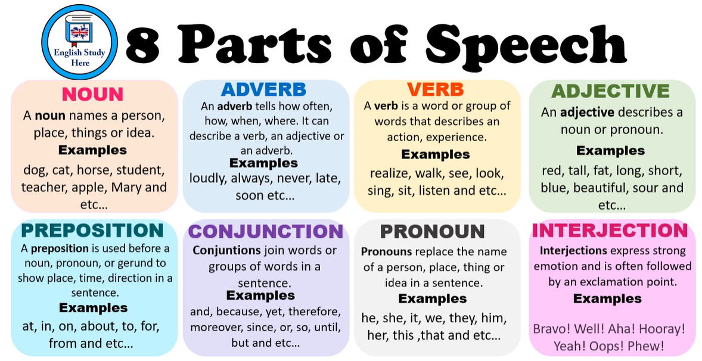

Slide 5
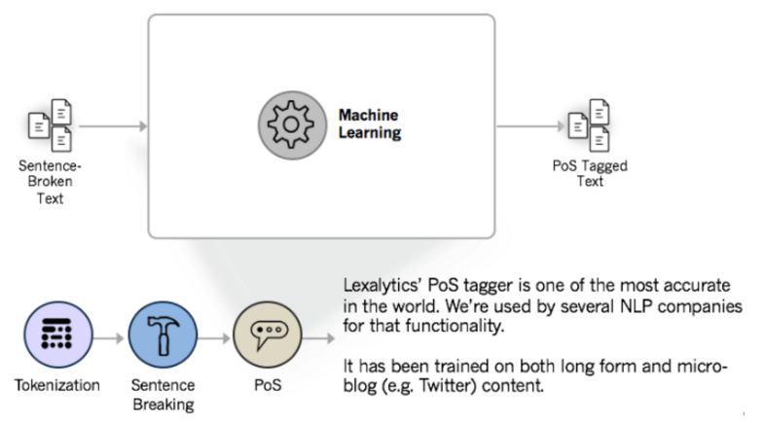
Part-of-Speech tagging
(PoS tagging) means identifying each token’s part of speech (noun, adverb, adjective, etc.) and then tagging it as such
Helps to disambiguate the meaning of words in different contexts (e.g., "bank" as a noun or verb).
Foundational step for NLP tasks, e.g. :
Named Entity Recognition
Syntactic parsing
Information extraction
Machine translation
Notes:
The assignment of the word can be based on its definition or the context to its relationship with adjacent and related words in a phrase, sentence, or paragraph

Slide 6
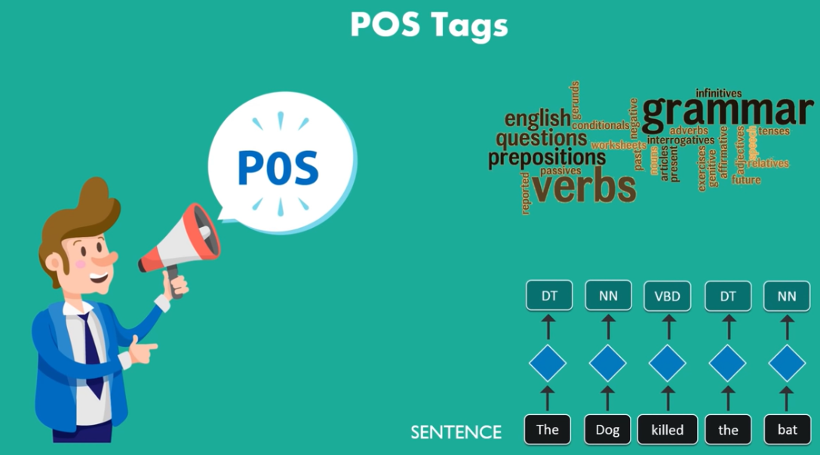

Slide 7
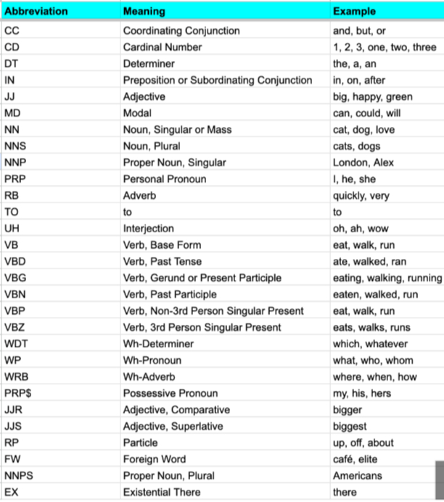
POS tagsets:
The Penn Treebank tagset
The Google Universal Tagset.

Slide 8
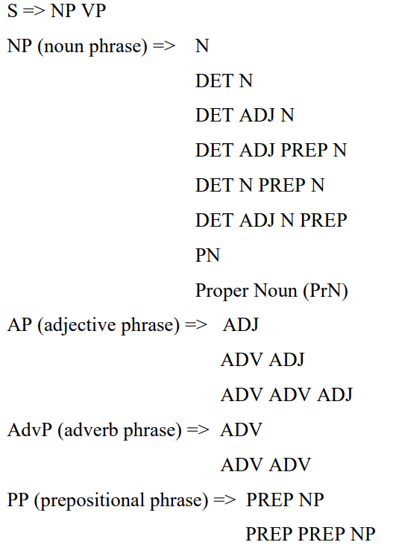
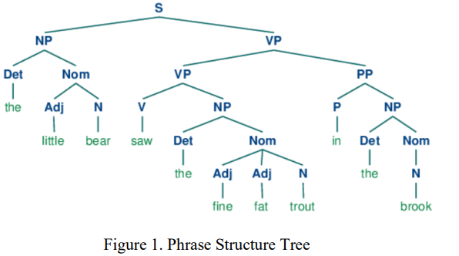

Slide 9
Rule-Based POS Tagging Methods
Rule-based: Relies on human-defined rules or manually crafted linguistic rules.
Example: The Brill Tagger, which uses a dictionary of tags and rules to correct initial guesses.
Advantages: Simple, interpretable, and useful for low-resource languages.
Disadvantages: Requires expert knowledge, not scalable, and struggles with ambiguous cases.
Notes:
The rule-based POS tagger utilized many linguistic rules to determine the tag of a word.
The set of rules are limited to a small set to prevent the occurrence of contradictions.
As the set of linguistic rules grow, the chance of contradiction also increases. Through limitation of a small set of rules, the tagger is unable to properly tag a word in a complex sentence.
Although stochastic taggers contain a higher degree of accuracy, there is great redundancy with their permutation generation for the sequence of tags.
Rule-based taggers reduce such redundancy with a small set of meaningful rules as opposed to large tables of statistics needed by the stochastic model.
These rules are based on the formal syntax of the language. In combination, a probabilistic model can be applied upon the rule-based model.
This allows the rulebased model to be more robust and reduced the redundancy that a pure stochastic model has

Slide 10
Stochastic POS Tagging
Uses statistical models to assign POS tags based on the likelihood of tag sequences.
Hidden Markov Models (HMMs): HMM-based POS tagging calculates the most probable sequence of tags for a given sequence of words using probability distributions.
Maximum Entropy Models and Conditional Random Fields (CRFs): Brief mention of these as more advanced models for POS tagging.
Notes:
Rule-based: Relies on human-defined rules.
Stochastic: Learns from annotated data (more flexible and scalable).
Many natural language processing (NLP) applications utilize stochastic techniques to determine part of speech.
The appeal of stochastic techniques over traditional rule based techniques comes from the ease of the necessary statistics automated acquisition.
In addition, rule based applications are often difficult to implement and not as robust
Stochastic taggers have obtained a high degree of accuracy without relying on pure syntactic analysis of the input.
These POS taggers rely on the Hidden Markov Model (HMM) which captures the lexical and contextual information

Slide 11
Workflow of POS Tagging in NLP
Tokenization : The first stage in NLP tasks
Loading Language Models: these offer a foundation for understanding a language’s grammatical structure
Text Processing: (optional) preprocess to handle special characters, lowercase, etc
Linguistic Analysis: Understanding each word’s purpose inside the sentence
POS Tagging: uses linguistic analysis to determine the text’s grammatical structure e.g. adjective, verb, noun
Results Analysis: Verify the accuracy and consistency of the PoS tagging findings with the source text.

Slide 12
Implementation of POS Tagging using NLTK
Import the NLTK library
Load dataset or Sample text
Perform PoS tagging
Display the PoS tags

Slide 13
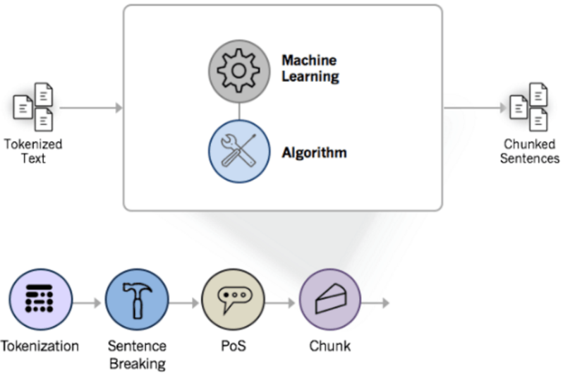
Chunking
Chunking means assigning PoS-tagged tokens to phrases
[the tall man]_np [is going to quickly walk]_vp [under the ladder]_pp

Slide 14
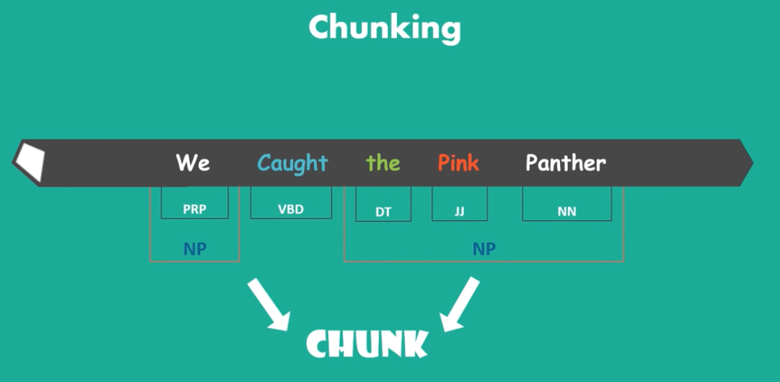

Slide 15
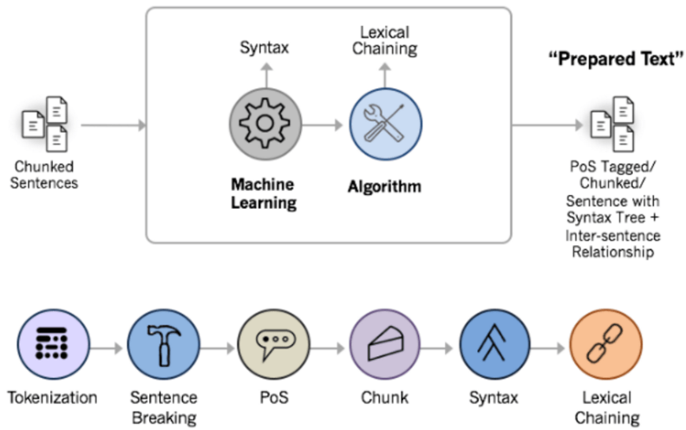
Syntax Parsing
The syntax parsing sub-function is a way to determine the structure of a sentence.
Notes:
The syntax parsing sub-function is a way to determine the structure of a sentence. In truth, syntax parsing is really just fancy talk for sentence diagraming. But it’s a critical preparatory step in sentiment analysis and other natural language processing features.
Syntax parsing is one of the most computationally-intensive steps in text analytics.

Slide 16
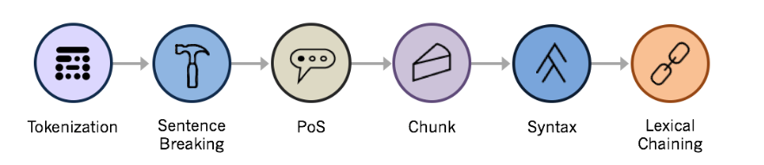
Sentence Chaining
Lexical chaining links individual sentences by each sentence’s strength of association to an overall topic
Notes:
Even if sentences appear many paragraphs apart in a document, the lexical chain will flow through the document and help a machine detect over-arching topics and quantify the overall “feel”.

Slide 17
Task: Data Preprocessing
Remove Stopwords
Replacing non-ASCII characters with spaces
Removal of HTML tags and punctuations
Lowercase all messages
Remove emoticons

Slide 18
Reference
NLP: https://www.youtube.com/watch?v=6WpnxmmkYys
NLT Book http://www.nltk.org/book/

